Slide 1
It’s No Accident: Evaluating the Effectiveness of Vehicle Safety Inspections
Hoagland and Woolley
Discussion by Jeff Denning

Slide 2
Question
Do safety inspections affect traffic fatalities?
Utah legislature was considering in 2017
Inspection is costly, newer vehicle may make it less important

Slide 3
Background
New Jersey got rid of safety inspections in 2010.
Data: US DoT Fatality Analysis Reporting System
Data on all traffic accidents resulting in fatalities
Data on registration (why is this important?)

Slide 4
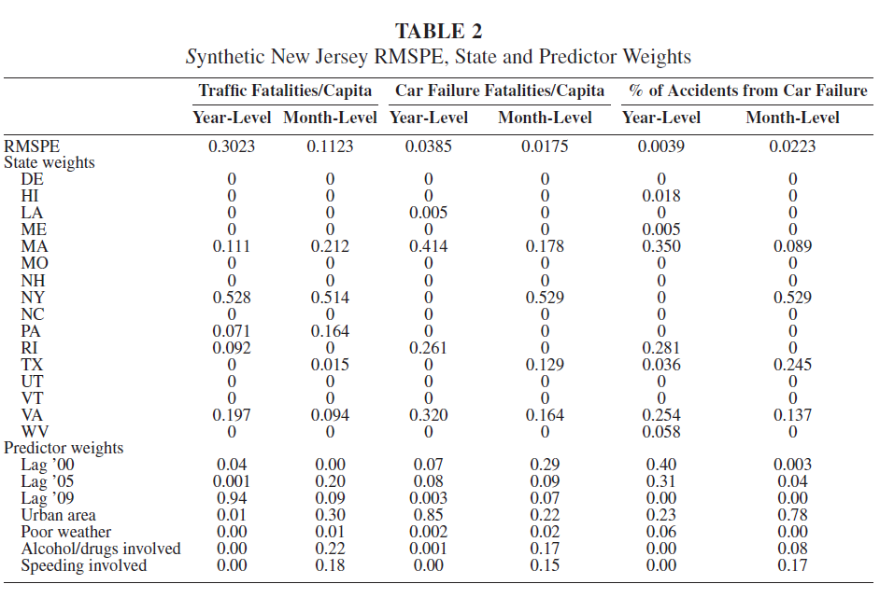
Synthetic New Jersey

Slide 5
What is the identifying assumption?
New Jersey would have followed the same path as synthetic New Jersey absent the policy change
Is there an issue with using neighboring states as donors?
How could they address this?
Nothing else changed
Cash for clunkers happened in 2009

Slide 6
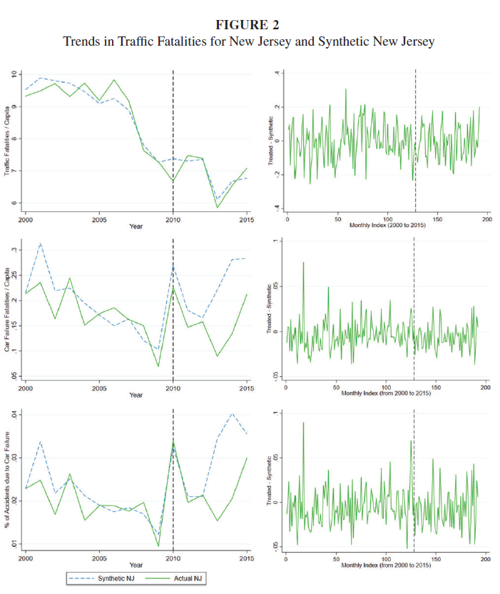

Slide 7
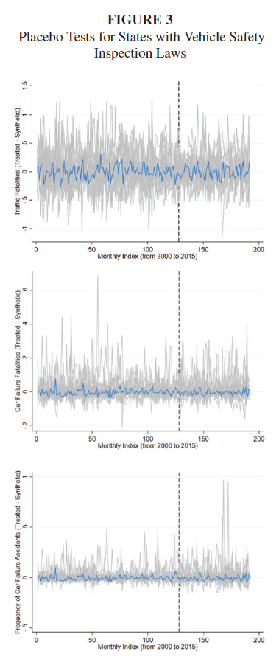

Slide 8
Findings
No effect on fatalities
This is true the farther out you go.
Unlikely to be an immediate change
What does this mean about the assumption they make about Synthetic NJ?

Slide 9
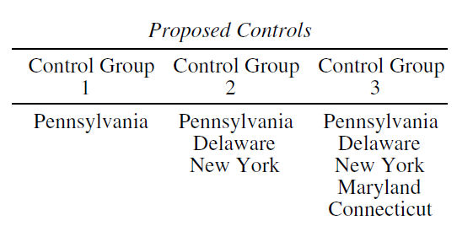
Differences in Differences

Slide 10
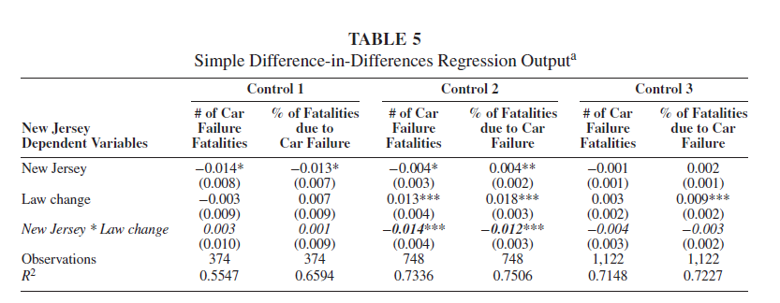
Differences in Differences

Slide 11
Conclusion
Safety inspections do not appear to affect mortality
True in synthetic control, and in Differences in Differences
This affected policy in Utah

